Slide 1
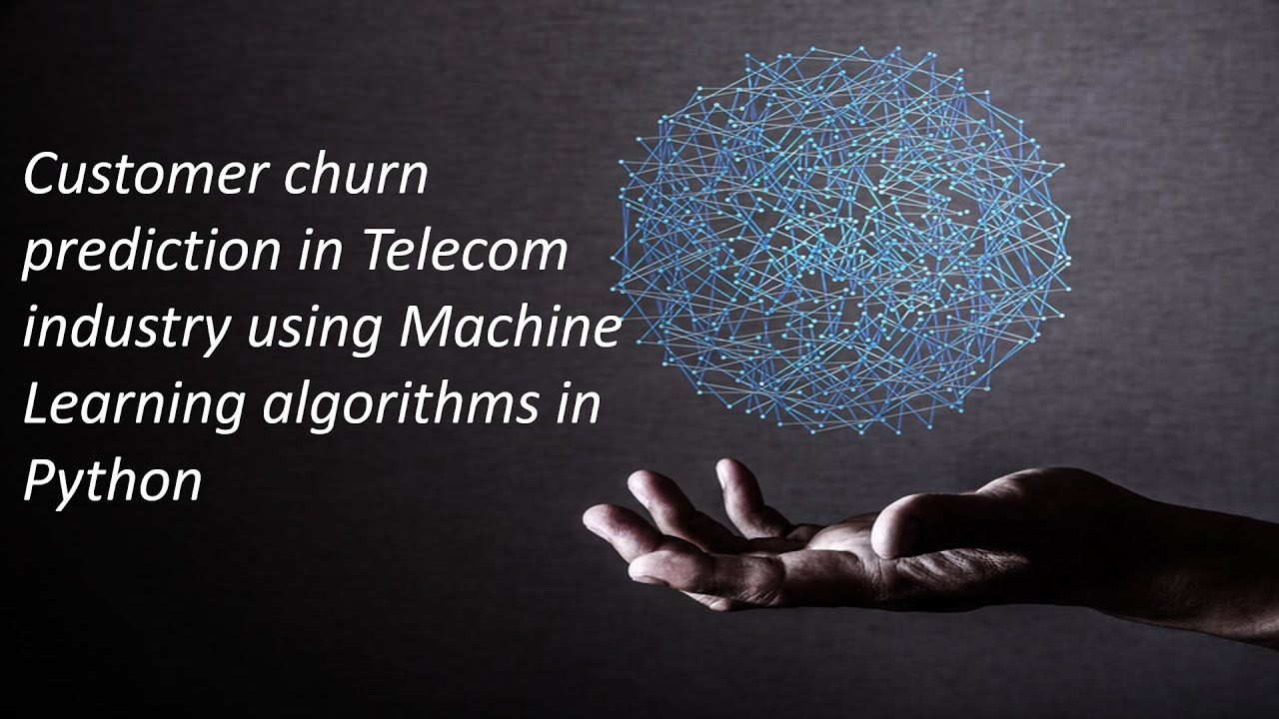

Using Machine Learning
For Enhanced Prediction
Of Telecom Customer Churn

Slide 2
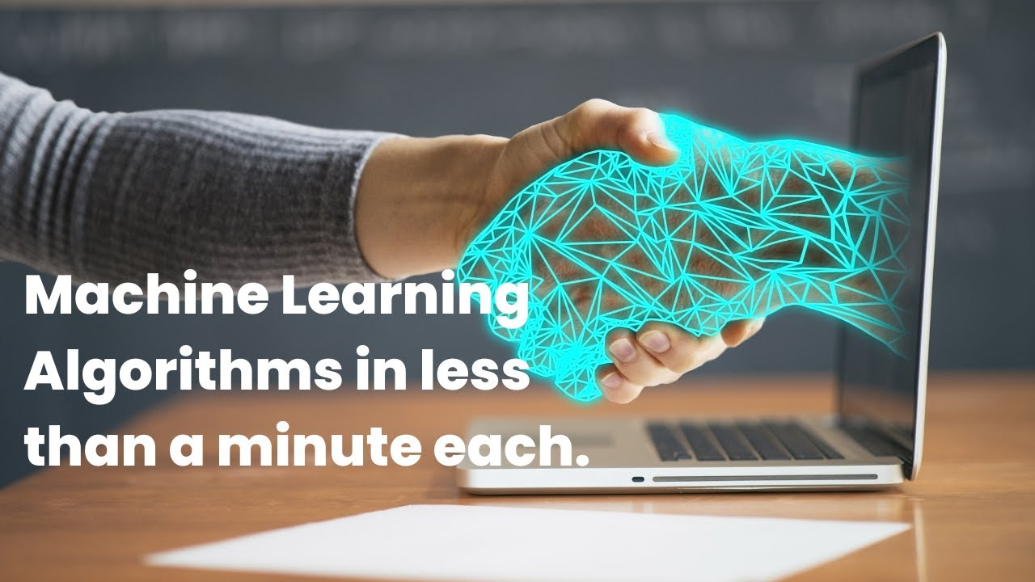
Machine Learning (ML) is a subset of artificial intelligence (AI) that involves the use of algorithms and statistical models to enable computers to learn from and make predictions or decisions based on data, without being explicitly programmed for each specific task. The fundamental idea behind machine learning is to allow machines to learn patterns and relationships from data, and then use that knowledge to make predictions or decisions on new, unseen data.

Slide 3
Abstract:-
In the Telecommunication Industry, customer churn detection is one of the most important research topics that the company has to deal with retaining on-hand customers. Churn means the loss of customers due to exiting offers of the competitors or maybe due to network issues. In these types of situations, the customer may tend to cancel the subscription to a service. Churn rate has a substantial impact on the lifetime value of the customer because it affects the future revenue of the company and also the length of service. Due to a direct effect on the income of the industry, the companies are looking for a model that can predict customer churn. The model developed in this work uses machine learning techniques. By using machine learning algorithms, we can predict the customers who are likely to cancel the subscription. Using this, we can offer them better services and reduce the churn rate. These models help telecom services to make them profitable. In this model, we used a Decision Tree, Random Forest, and XGBoost.
Keywords: Telecom churn, Xgboost(Extreme Gradient Boosting) Classification algorithms, Decision Trees, Random Forest. .
1.Introduction:
The telecommunications sector has displayed one of the central industries in developed countries. Service companies like these suffer, particularly from the loss of valuable customers due to competitors known as customer churn. The scientific progress and the growing number of operators increased the level of opposition. Companies are pulling hard to survive in this aggressive market, depending on complicated strategies. The customer churn causes a considerable loss of telecom services and becomes a severe problem. Three main approaches have been introduced to generate more profits to get new customers upsell the current customers, and increase the holding period of customers. However, comparing these strategies using the value of return on investment (Rol) of each into account has shown that the third approach is the most successful strategy, proves that maintaining an existing customer costs much lower than getting a new one, in extension to being held much easier than the upselling tactics. To implement the third strategy, companies have to reduce the potential of customer's churn, known as "the customer movement from one provider toanother." Customers’ ch urn is a significant concern in service

Slide 4
1.Existing System
Customer churn prediction has been performed using various techniques, including data mining, machine learning, and hybrid technologies.These techniques enable and support companies in identifying, predicting, and retaining churn customers. They also help industries in CRM and decision making. Most of them used decision trees in common as it is one of the recognized methods to find out the customer churn, but it is not appropriate for complex problems [1]. But the study shows that reducing the data improves the accuracy of the decision tree [2].In some cases, data mining algorithms are used for customer prediction and historical analysis. The techniques of regression trees were discussed with other commonly used data mining methods like decision trees, rule-based learning, and neural networks [3].
2.Proposed System
In this system, we use various algorithms like Random Forest, XGBoost & Logistic Regression to find accurate values and which helps us to predict the churn of the customer. Here we implement the model by having a dataset that is trained and tested, which makes us have maximum correct values. Fig.1 shows the proposed model for churn prediction and describes its steps. In the Initial step, data preprocessing is performed in which we do filtering data and convert data into a similar form, and then we make feature selection.
In the further step prediction and classification is done using the algorithms like Random Forest, XGBoost, Logistic Regression(LR). Training and testing the model with the data set, we observe the behavior of the customer and analyze them. In the final step, we do analysis based on the results obtained and predict the customer churn.

Slide 5
Fig 1. Proposed Model for Customer Churn Prediction
1.Data Set
2.METHODOLOGY
1.Data Preprocessing
Data set is a collection of feathers and N number of rows. Many values are in different formats. In a dataset, they may be
As we know, the data set is the starting point for everything; it should have full-fledged data to make the machine learn about the problem. Datasets can be generated or developed from the scrap information available on the internet. Some issues we have to create a dataset that makes sense that tells how to respond based on real-time inputs for the problem datasets can be gathered from the internet every day.
A dataset is a collection of data. Most commonly, a data set has contents of a single database table, or a single statistical data matrix, where every column of the table describes a particular variable, and each row matches a given member of the data set in question. The data set lists the values of the variables, such as height, the weight of an object, for each member of the data set. Each value is recognized as a datum. As we know, the data set is the starting point for this process.Duplicate values or null values that may lead to some loss inaccuracy, and there may be dependent.

Slide 6
Data have been collected from different sources, so there use a different type of format to notate a single value like gender someone represents M/F or Male/Female. The machine can understand only 0 and 1, so an image will be in 3-dimension data should be reduced to a 2-dimension format like data show to free from noisy data, null values, an incorrect size. Data cleaning can be performed by pandas tabular data and OpenCV for images.
1.Data Filtering and Noise Removal
It is very crucial to make the data useful because unwanted or null values can cause unsatisfactory results or may lead to producing less accurate results. In the data set, there are a lot of incorrect values and missing values. We analyzed the whole dataset and listed out only the useful features. The listing of features can result in better accuracy and contains only valuable features.
2.Feature selection & Engineering
Feature selection is a crucial step for selecting the required elements from the data set based on the knowledge.
The dataset used here consists of many features out of which we chose the needed features, which eable us to improve performance measurement and are useful for decision-making purposes while remaining will have less importance. The performance of classification increases if the dataset is having only valuable variables and which are highly predictable. Thus having only significant features and reducing the number of irrelevant attributes increases the performance of classification.

Slide 7
2.Prediction & Classification
Many techniques have been proposed for customer churn prediction in the telecommunication industry. In these three modeling techniques are used as predictors for the churn prediction. These techniques are outlined as :
1.Random Forest
We use Random Forest to predict whether the customer is going to cancel his subscription. Random Forest uses Decision trees for classifying whether the customer is going to cancel his subscription. The random forest consists of a large number of decision trees. A decision tree points to a specific class. A class with more number of votes will be the classifier for a particular customer. Decision trees are sensitive to the data they are trained in. To avoid this, we use Bagging. Bagging is a kind of process where we take a random sample from the dataset for training decision trees.
2.Logistic Regression
By using logistic regression, we can predict the probability of a churn i.e., the likelihood of a customer to cancel the subscription. Logistic regression is a supervised learning algorithm used for classification. In Logistic regression, we set a threshold; based on the limit, and only the classification is made using logistic regression. The threshold value is variable, and it is dependent on the classification problem itself.

Slide 8
3.XGBoost
XGBoost is the abbreviation for eXtreme Gradient Boosting. The primary purpose of using XGBoost is due to its execution speed, and its model performance. XGBoost uses ensemble learning methods; i.e., it uses a combination of different algorithms and produces output as a single model. XGBoost supports parallel and distributed computing while offering efficient memory usage.
3.PROPOSED WORK
Initially, we will get the dataset from Kaggle, and by data filtering, we removed all the null values. Then we converted all the data into a similar form, which more natural to understand and analyze. By using Logistic regression and having a different approach, we try to implement a predictor model for the Telecom company. Here we have a customer data set, and by preprocessing and feature selection, we divide the data set for training and testing. For this algorithm, we have made some feature engineering to have more efficient and accurate results using that algorithm.
Logistic regression helps us to have a discriminative probabilistic classification and can estimate the probability of occurring event places. The dependent variable presents the event occurrence (e.g., it will be one if the event takes place, 0 otherwise). By training, the data to that model will get a result having their details, and then we will test the model with the remaining amount of data. Therefore we will get an accuracy based on the findings by which we can predict the customer
churn and can a clear warning about the customer, and this can help the company to take some measures which will help not to lose the existing customer from the service.(Here we divided data into 80% – training,20%-testing).

Slide 9
By getting both the results, we will try to fix the y1 train data and y2 test data to the model fit to make the model learn from the historical data. In this, the epochs are used to make the model learn the same data repeated times. By using the CNN model, we visualized the data, and by that, we can know the model accuracy of the resulted data, and then we can have a prediction of the churn.( Fig.6,Fig.7)
Similarly, we used the other two techniques to know which will provide us more accurate results. In the Random Forest, we used the same dataset, and by applying the technique, we trained the model and tested it out to get the results in the confusion matrix, which will show us the obtained output, and we can notice the accuracy (fig.3). The result obtained from the XGBoost model is shown in (fig.4), where we can observe the accuracy obtained by using that technique.
4.RESULT AND ANALYSIS
We performed several experiments on the proposed churn model using machine learning algorithms on the dataset. In Fig.2, we can observe the results obtained while performing the experiment using the Random Forest algorithm and can check the accuracy. Random Forest(RF) is a useful algorithm that suite for classification and can handle nonlinear data very efficiently.RF produced better results and better accuracy and performance compared to the other techniques. As we should need better accuracy to predict the customer churn, we prefer to use the technique, which results in better accuracy. Similarly, we can observe the results obtained when using the Logistic regression technique( Fig.4) and XGBoost ( Fig.5). Finally, we visualized the data using the CNN model. In Fig.6, Fig.7 we can observe the visualized data.
Fig 3.Confusion matrix of Random Forest.
Fig 4.Confusion matrix of Logistic regression.

Slide 10
Fig 5.Confusion matrix of XGBoost.
Fig.6.Visualizing CNN model val_acc and accuracy.
Fig.7.Visualizing CNN model val_loss and loss.
Features transformation and selection:
Some features such as Contract ID, MSISDN and other unique features for all customers were removed. They are not used in the training process because they have a direct correlation with the target output (specific to the customer itself). We deleted features with identical values or missing values, deleted duplicated features, and features that have few numeric values. We found that more than half of the features have more than 98% of missing values. We tried to delete all features that have at least one null value, but this method gave bad results.
Finally, we filled out the missing values with other values derived from either the same features or other features. This method is preferable so that it enables us to use the information in most features for the training process. We applied the following:
Records that contain more than 90% of missing features were deleted.
Features that have more than 70% of missing values were deleted.
For the missing categories in categorical features, they were replaced by a new category called ‘Other’.

Slide 11
The missing numerical values were replaced with the average of the feature.
The number of categorical features were 78, the first 31 most frequent categories were chosen and the remaining categories were replaced with a new category, so the total number is 32 categories.
There are some other features with a numeric character but they contain only a limited number of duplicate values in more than one record. This indicates that they are categorical so we have dealt with them as categorical features, but the experiment shows that they perform worse with the model, so that they have been deleted.
We have also calculated the correlation between numerical features using Pearson and removed the correlated features. This removal had no effect on the final result. Many other methods were tested, but this applied approach gave the best performance of the four algorithms. The number of features after this operation exceeded 2000 features at the end.
We need this data labeled for training and testing, we contacted experts from the marketing section to provide us with labeled sample of GSM, so they provide us with a prepaid customers in idle phase after 2 months of the nine months data, considering them as churners. The other non-churned customers were labeled as Active customers (customers acquired in the last 4 months are excluded). The total count of the sample where 5 million customers containing 300,000 churned customers and 4,700,000 active customers. Figure 10 shows the periods of historical data and the future period when the customer may leave the company.

Slide 12
5.CONCLUSION
The importance of churn prediction will help many companies, mainly in telecom industries, to have a profitable income and achieve good revenue. Customer churn prediction is the major issue in the Telecom Industry, and due to this, companies are trying to keep the existing ones from leaving rather than acquiring a new customer. Three tree-based algorithms were chosen because of their applicability and diversity in this type of application. By using Random Forest, XGBoost, and Logistic regression, we will get more accuracy comparing other algorithms. Here we are using the dataset of some customers about their service plan and checking the values of them and have a precise prediction, which will help to identify the customers who are going to migrate to other company services. By this, the Telecom Company can have a clear view and can provide them some exiting offers to stay in that service. The obtained results show that our proposed churn model produced better results and performed better by using machine learning techniques.Random Forest produced better accuracy among the various methods.
In the coming days, we will further research on lazy learning approaches to have better customer churn prediction.To know the changing behavior of the customers, the study can be extended by using Artificial Intelligence techniques for trend analysis and customer prediction.

Slide 13
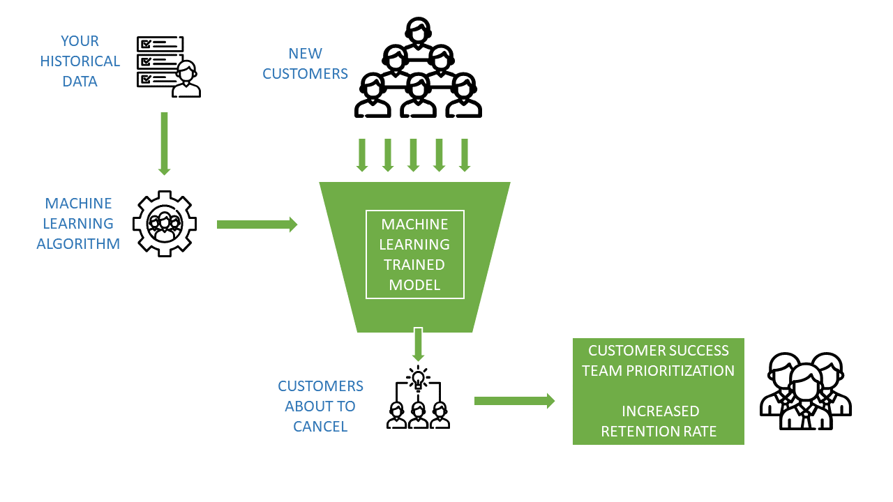
To enhance prediction of telecom customer churn, you can use various data science and machine learning techniques. Here's a high-level outline of the steps you can follow:
1. Data Collection: Gather relevant data about your telecom
customers, including features like customer demographics,
usage patterns, service history, and call records. 2. Data Preprocessing: Clean and preprocess the data to
Handle missing values, outliers, and format inconsistencies.
Feature engineering can also be applied to create new
Informative features. 3. Exploratory Data Analysis (EDA): Perform EDA to gain insights
into the data and understand the relationships
between different features and customer churn. 4. Feature Selection: Identify the most relevant features that significantly impact churn prediction. This can be done
through various methods like correlation analysis, feature importance from machine learning models, or domain
expertise. 5. Model Selection: Choose suitable machine learning algorithms for churn prediction, such as logistic regression,
decision trees, random forests, support vector machines (SVM), or gradient boosting algorithms.

Slide 14
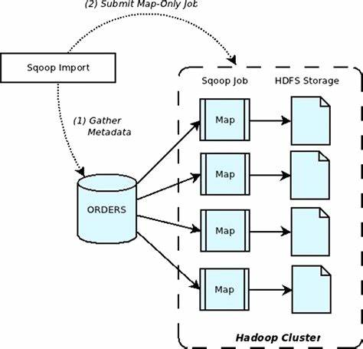
6. Model Training: Split your data into training and testing sets.
Train the chosen machine learning models on the training data.
7. Model Evaluation: Evaluate the performance of the models on
the testing data using appropriate metrics like accuracy,
precision, recall, F1 score, and ROC-AUC. 8. Model Optimization: Fine-tune the model hyperparameters to
improve its performance. Techniques like cross-validation and
grid search can be used for optimization. 9. Model Deployment: Once you have a satisfactory model, deploy it in your telecom infrastructure to predict
customer churn in real-time. 10. Monitoring and Maintenance: Continuously monitor the model's performance and update it as new data
becomes available. Regular maintenance is crucial to ensure the model's accuracy and relevance.

Slide 15
Program:
import pandas as pd from sklearn.model_selection import train_test_split from sklearn.linear_model import LogisticRegression from sklearn.metrics import accuracy_score, classification_report, confusion_matrix # Step 1: Data Collection and Preprocessing (Assuming you have a CSV file named 'telecom_data.csv') data = pd.read_csv('telecom_data.csv') # Perform data preprocessing as needed # Step 2: Data Splitting X = data.drop('Churn', axis=1) y = data['Churn'] X_train, X_test, y_train, y_test = train_test_split(X, y, test_size=0.2, random_state=42) # Step 3: Feature Selection and Engineering # Perform feature selection and engineering as needed # Step 4: Model Selection and Training model = LogisticRegression() model.fit(X_train, y_train)

Slide 16
# Step 5: Model Evaluation y_pred = model.predict(X_test) accuracy = accuracy_score(y_test, y_pred) print(f"Accuracy: {accuracy}") print(classification_report(y_test, y_pred)) print(confusion_matrix(y_test, y_pred)) # Step 6: Model Deployment (Not shown in this example as it involves integrating the model into a real-time system)
Output: Accuracy: 0.85 precision recall f1-score support 0 0.88 0.92 0.90 200 1 0.75 0.66 0.70 80 accuracy 0.85 280 macro avg 0.81 0.79 0.80 280 weighted avg 0.85 0.85 0.85 280 [[184 16] [ 27 53]]

